Slide 1
SDN Dev Group, Week 1
SDN Software Stack
Aaron Gember Aditya Akella
University of Wisconsin-Madison

Slide 2
Slides Originally From
Tutorial 1: SDN for Engineers part of the the Open Networking Summit
April 16, 2012
Brandon Heller, Rob Sherwood, David Erickson, Hideyuki Shimonishi, Srini Seetharaman, Murphy McCauley

Slide 3
What is SDN, opt. 1
“The McKeown View”:
Refactoring Functionality
Define SDN by its placement of functionality.

Slide 4
Today
Closed Boxes, Fully Distributed Protocols
Closed
App
App
App
Operating
System
Specialized Packet Forwarding Hardware
App
App
App
Operating
System
App
App
App
Specialized Packet Forwarding Hardware
Operating
System
App
App
App
Specialized Packet Forwarding Hardware
Operating
System
Specialized Packet Forwarding Hardware
App
App
App
Operating
System
Specialized Packet Forwarding Hardware
4
Notes:
Historical artifact that forwarding boxes host the code too. Leads to a specific design point for networks. Great for the internet, not so much for the networks the internet connects.
Note each piece.

Slide 5
The “Software-defined Network”
2. At least one good operating system
Extensible, possibly open-source
3. Well-defined open API
App
App
App
Network Operating System
1. Open interface to hardware
Simple Packet Forwarding Hardware
Simple Packet Forwarding Hardware
Simple Packet Forwarding Hardware
Simple Packet Forwarding Hardware
Simple Packet Forwarding Hardware
5
Notes:
Switches, routers and other middleboxes are dumbed down
The key is to have a standardized control interface that speaks directly to hardware

Slide 6
Isolated “slices”
Many operating systems, or
Many versions
App
App
App
App
App
App
App
App
Network Operating System 1
Network Operating System 2
Network Operating System 3
Network Operating System 4
Open interface to hardware
Virtualization or “Slicing” Layer
Open interface to hardware
Simple Packet
Forwarding Hardware
Simple Packet
Forwarding Hardware
Simple Packet
Forwarding Hardware
Simple Packet
Forwarding Hardware
Simple Packet
Forwarding Hardware

Slide 7
What is SDN, opt. 2
“The Shenker View”:
Redefining Abstractions
Define SDN by the abstractions it provides to software (and people writing it).
Notes:
Not just about where the functionality is implemented, but about defining a new set of abstractions for thinking about those interface

Slide 8
Forwarding Abstraction
Forwarding behavior specified by a control program.
Possibilities: x86, MPLS, OpenFlow

Slide 9
State Distribution Abstraction
Control program should not have to handle distributed-state details
Proposed abstraction: global network view
Control program operates on network view
  Input: global network view (graph)
  Output: configuration of each network device
Network OS provides network view
Short version: programs operate on graphs
Notes:
Note difference between being asked to build OSPF vs implementing Dijskstra’s algorithm.

Slide 10
Specification Abstraction
Give control program abstract view of network
Provide enough detail to specify goals, but not to implement them

Slide 11
What SDN really means is up in the air.
Here’s a good definition, though:
Software Defined Networking (SDN) is a refactoring of the relationship between network devices and the software that controls them.
[Paraphrased from the HotSDN ‘12 Solicitation]
Notes:
We’re been talking in the abstract; now, let’s move to the concrete

Slide 12
The SDN Stack
Simple Switch
CloudNaaS
Stratos
…
Applications
NOX
Beacon
Trema
Maestro
…
Controller
Slicing
Software
FlowVisor
Console
FlowVisor
Commercial Switches
Software
Ref. Switch
NetFPGA
Broadcom
Ref. Switch
HP, NEC, Pronto, Juniper.. and many more
OpenFlow
Switches
OpenWRT
PCEngine
WiFi AP
Open vSwitch
12
Notes:
There are components at different levels that work together in making it work
The commercial switch details will follow in next slide
There are a plethora of applications possible. I only list those available at Stanford

Slide 13
The SDN Stack
Controller
OpenFlow
Switches
13
Notes:
There are components at different levels that work together in making it work
The commercial switch details will follow in next slide
There are a plethora of applications possible. I only list those available at Stanford

Slide 14
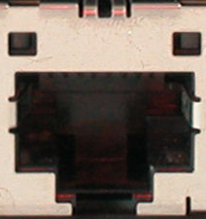
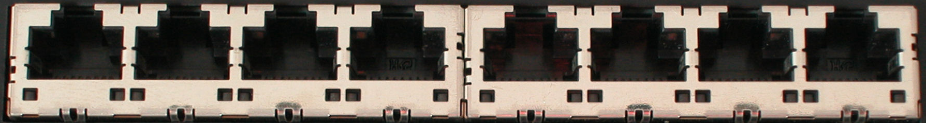
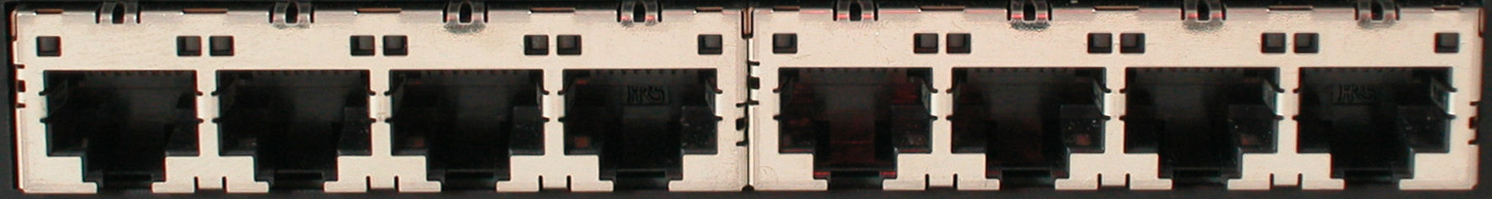
How does OpenFlow work?
Ethernet Switch

Slide 15
Control Path
Control Path (Software)
Data Path (Hardware)

Slide 16
OpenFlow Controller
OpenFlow Protocol (SSL/TCP)
Control Path
OpenFlow
Data Path (Hardware)

Slide 17
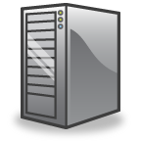

OpenFlow Example
Controller
OpenFlow Client
PC
Software
Layer
Flow Table
MAC
src
MAC
dst
IP
Src
IP
Dst
TCP
sport
TCP
dport
Action
Hardware
Layer
*
*
*
5.6.7.8
*
*
port 1
port 1
port 2
port 3
port 4
5.6.7.8
1.2.3.4

Slide 18
OpenFlow Basics
Flow Table Entries
Rule
Action
Stats
Packet + byte counters
Forward packet to zero or more ports
Encapsulate and forward to controller
Send to normal processing pipeline
Modify Fields
Any extensions you add!
Switch
Port
VLAN
ID
VLAN
pcp
MAC
src
MAC
dst
Eth
type
IP
Src
IP
Dst
IP
ToS
IP
Prot
L4
sport
L4
dport
+ mask what fields to match
Notes:
Now I’ll describe the API that tries to meet these goals.

Slide 19
Examples
Switching
Switch
Port
MAC
src
MAC
dst
Eth
type
VLAN
ID
IP
Src
IP
Dst
IP
Prot
TCP
sport
TCP
dport
Action
*
*
00:1f:..
*
*
*
*
*
*
*
port6
Flow Switching
Switch
Port
MAC
src
MAC
dst
Eth
type
VLAN
ID
IP
Src
IP
Dst
IP
Prot
TCP
sport
TCP
dport
Action
port3
00:20..
00:1f..
0800
vlan1
1.2.3.4
5.6.7.8
4
17264
80
port6
Firewall
Switch
Port
MAC
src
MAC
dst
Eth
type
VLAN
ID
IP
Src
IP
Dst
IP
Prot
TCP
sport
TCP
dport
Action
*
*
*
*
*
*
*
*
*
22
drop

Slide 20
OpenFlow Progression
OF v1.0: released end of 2009: “Into the Campus”
OF v1.1: released March 1 2011: “Into the WAN”
  multiple tables: leverage additional tables
  tags and tunnels: MPLS, VLAN, virtual ports
  multipath forwarding: ECMP, groups
OF v1.2: approved Dec 8 2011: “Extensible Protocol”
  extensible match
  extensible actions
  IPv6
  multiple controllers

Slide 21
The SDN Stack
Controller
Commercial Switches
Software
Ref. Switch
NetFPGA
Broadcom
Ref. Switch
HP, NEC, Pronto, Juniper.. and many more
OpenFlow
Switches
OpenWRT
PCEngine
WiFi AP
Open vSwitch
21
Notes:
There are components at different levels that work together in making it work
The commercial switch details will follow in next slide
There are a plethora of applications possible. I only list those available at Stanford

Slide 22
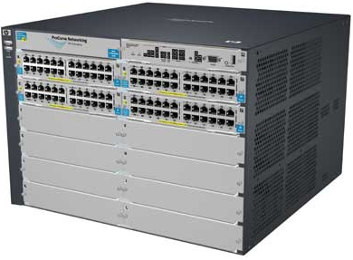
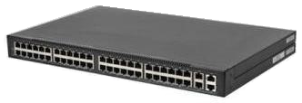
Switches
Vendor | Models | Virtualize? | Notes | Image
HP ProCurve | 5400zl, 6600, + | 1 OF instance per VLAN | LACP, VLAN and STP processing before OF Wildcard rules or non-IP pkts processed in s/w Header rewriting in s/w CPU protects mgmt during loop
Pronto/ Pica8 | 3290, 3780, 3920, + | 1 OF instance per switch | No legacy protocols (like VLAN and STP) Most actions processed in hardware MAC header rewriting in h/w
Name | Lang | Platform(s) | Original Author | Notes
OpenFlow Reference | C | Linux | Stanford/Nicira | not designed for extensibility
Open vSwitch | C/ Python | Linux/BSD? | Ben Pfaff/Nicira | In Linux kernel 3.3+
Indigo | C/Lua | Linux-based Hardware Switches | Dan Talayco/BigSwitch | Bare OpenFlow switch
Notes:
Language open-source Performance cross-platform runtime modular

Slide 23
The SDN Stack
NOX
Beacon
Trema
Maestro
…
Controller
Commercial Switches
Software
Ref. Switch
NetFPGA
Broadcom
Ref. Switch
HP, NEC, Pronto, Juniper.. and many more
OpenFlow
Switches
OpenWRT
PCEngine
WiFi AP
Open vSwitch
23
Notes:
There are components at different levels that work together in making it work
The commercial switch details will follow in next slide
There are a plethora of applications possible. I only list those available at Stanford

Slide 24
Controllers
Name | Lang | Original Author | Notes
OpenFlow Reference | C | Stanford/Nicira | not designed for extensibility
NOX | Python, C++ | Nicira | actively developed
Beacon | Java | David Erickson (Stanford) | runtime modular, web UI framework, regression test framework
Maestro | Java | Zheng Cai (Rice)
Trema | Ruby, C | NEC | includes emulator, regression test framework
RouteFlow | ? | CPqD (Brazil) | virtual IP routing as a service
POX | Python
Floodlight | Java | BigSwitch, based on Beacon
Too many to easily keep track of…
http://yuba.stanford.edu/~casado/of-sw.html
Notes:
Language open-source Performance cross-platform runtime modular

Slide 25
The SDN Stack
NOX
Beacon
Trema
Maestro
…
Controller
Slicing
Software
FlowVisor
Console
FlowVisor
Commercial Switches
Software
Ref. Switch
NetFPGA
Broadcom
Ref. Switch
HP, NEC, Pronto, Juniper.. and many more
OpenFlow
Switches
OpenWRT
PCEngine
WiFi AP
Open vSwitch
25
Notes:
There are components at different levels that work together in making it work
The commercial switch details will follow in next slide
There are a plethora of applications possible. I only list those available at Stanford

Slide 26



FlowVisor Creates Virtual Networks
Simple switch
CloudNaaS
Stratos
Each application runs in an isolated slice of the network.
OpenFlow
Protocol
OpenFlow
Protocol
OpenFlow
Switch
FlowVisor
Reservations
FlowVisor slices OpenFlow networks, creating multiple isolated and programmable logical networks on the same physical topology.
OpenFlow
Switch
OpenFlow
Switch

Slide 27
The SDN Stack
Simple Switch
CloudNaaS
Stratos
…
Applications
NOX
Beacon
Trema
Maestro
…
Controller
Slicing
Software
FlowVisor
Console
FlowVisor
Commercial Switches
Software
Ref. Switch
NetFPGA
Broadcom
Ref. Switch
HP, NEC, Pronto, Juniper.. and many more
OpenFlow
Switches
OpenWRT
PCEngine
WiFi AP
Open vSwitch
27
Notes:
There are components at different levels that work together in making it work
The commercial switch details will follow in next slide
There are a plethora of applications possible. I only list those available at Stanford

Slide 28
Example SDN Applications
Wisconsin Projects
Stanford Demos
Stratos
CloudNaaS
OpenSAFE
ECOS
Wireless mobility
VM mobility/migration
Network virtualization
Power management
Load balancing
Traffic Engineering

Slide 29
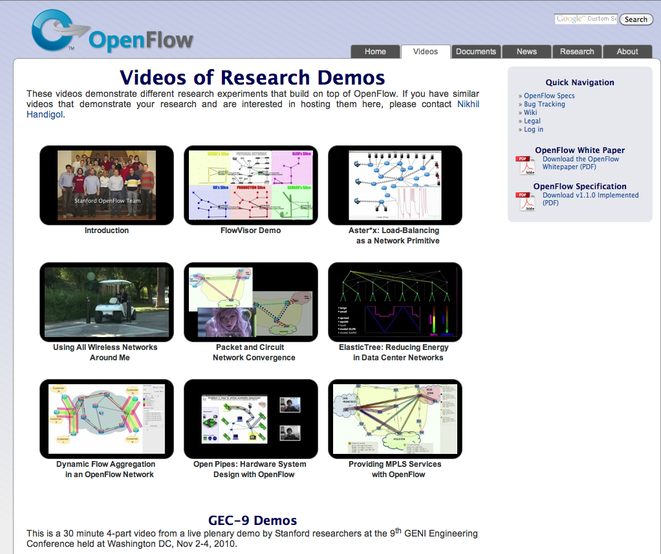
openflow.org/videos

Slide 30
Related Research
DIFANE
  Rule partitioning for controller-less flow insertion
ONIX
  Fault-tolerant controller platform from Nicira, Google, NEC
DevoFlow
  Practical scalability limits to OpenFlow and modifications to get around them
Frenetic/Nettle
  Functional Reactive Programming for more composable, reusable controller code

Slide 31
Related Research
Consistency Primitives
  Per-packet or per-flow routing guarantees to simplify network versioning
HotSDN 2012

Slide 32
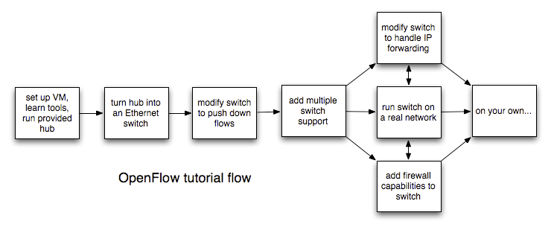
OpenFlow Tutorial

Slide 33
Getting Answers
Mailing lists:
  openflow-discuss
  openvswitch-{discuss/dev}
  Lists for specific controllers
Wikis for OpenFlow, controllers, etc.

Slide 34
SDN Dev Group Week 2
Preparation
  Finish OpenFlow tutorial
  (Try vendor extensions in Open vSwitch)
  Skim OpenFlow 1.0 and 1.2 standards
Meeting topics
  UW-Madison OpenFlow testbed

Slide 35
SDN Dev Group Week 3
Preparation
  Use UW-Madison OpenFlow testbed
  TBD: Read Stratos? ONIX?
Meeting topics
  TBD

